Slide 1
Data Structure and Algorithms
Azaz Ahmed Kiani

Slide 2
Guidelines
Start working on projects/assignments from first day.
Come prepared in the class.
Read book (s) and Interactive Session case studies
Remain attentive during the class.
I will ask questions very often

Slide 3
Recommended books
Data Structures by Gillberg Forouzan (Fourth Edition), Latest Edition
Data Structures and Algorithms in C++ by Adam Drozdek, 4th edition, 2012
Data Structures and Algorithm Analysis in C++ by Mark Allen Weiss, 4th edition, 2013.

Slide 4
Course Objectives
At the end of the course the students will be able to
Implement various data structures and their algorithms, and apply them in implementing simple applications
Analyze simple algorithms and determine their complexities.
Apply the knowledge of data structures to other application domains
Design new data structures and algorithms to solve problems

Slide 5
Introduction to Data Structure and Algorithms
Lecture: 1,2

Slide 6
Three Fundamental C Program Stages
myprog.c
myprog.obj
myprog.exe
SOURCE
OBJECT
EXECUTABLE
written in
C
written in
machine
language
written in
machine
language
via compiler
via linker
other code from
libraries, etc.
(also in machine
language)

Slide 7
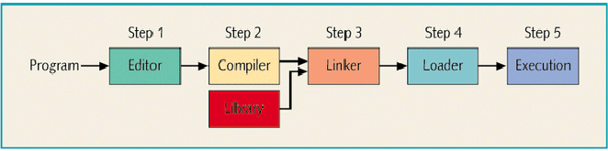
Processing a program (graphic)
CPU schedules (and executes) programs in main memory
source program
object program
executable code
other object programs
Loads executable program into main memory

Slide 8
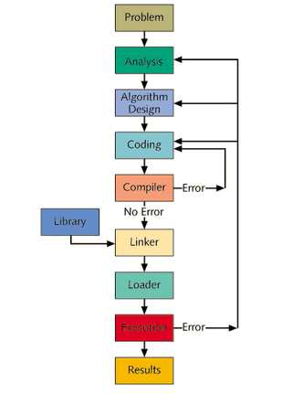
Problem Analysis: Coding-Execution Cycle

Slide 9
Data Structures and Algorithms
Algorithm
  A high level, language independent description of a step-by-step process for solving a problem
  Method for solving a problem
  Can be represented in any language
Data Structure
  A way to store information
  A scheme for organizing related pieces of information
Notes:
A data structure will be a set of algorithms for implementing an abstract data type.
One ADT often has many data structures implementing it.

Slide 10
Data Structure
Scheme for organizing Data

Slide 11
Data
Variable
  the name given to a collection of memory cells, designed to store a particular data item
  the value stored in that variable may change or vary as the program executes
Constant
  a data item with a name and a value that remain the same during the execution of the program (e.g. 8, 10)
Literal
  a constant whose name is the written representation of its value (e.g. “8”, “10”)

Slide 12
Data type
Integers
  whole numbers
Real
  Numbers with a decimal point
  Two choices in VB: single and double
Character
Boolean
  True or False

Slide 13
Data Structures (also called data aggregates)
Record
  One set of related data
    A time card; an invoice
File
  A set of related records
Array
  A collection of data that have same data type
String
  An array of characters
    Hello Daniel Chen

Slide 14
Simple Data Types
    Memory:
    2-state devices ↔ bits 0 and 1
    Organized into bytes (8 bits) and
    words (machine dependent — e.g., 4 bytes).
    Each byte (or word) has an address making it possible to store and retrieve contents of any given memory location.
    Therefore:
    the most basic form of data: sequences of bits
     simple data types (values are atomic — can't be subdivided) are ADTs.
    Implementations have:
    » Storage structures: memory locations
    » Algorithms: system hardware/software to do basic operations.

Slide 15
Boolean data
Data values: {false, true}
In C/C++: false = 0, true = 1 (or nonzero)
Operations: and &&
or ||
not !
&& | 0 | 1
0 | 0 | 0
1 | 0 | 1
| | | 0 | 1
0 | 0 | 1
1 | 1 | 1
x !x
0 1
1 0

Slide 16




Character Data
Store numeric codes (ASCII, EBCDIC, Unicode)
1 byte for ASCII and EBCDIC,
2 bytes for Unicode
ASCII/EBCDIC
Unicode
,
Basic operation: comparison to determine if
Equal, Less than
Greater
than
, etc. use their numeric codes (i.e. use ordinal value)

Slide 17
Integer Data
Nonegative (unsigned) integer:
Store its base-two representation in a fixed number w of bits
    (e.g., w = 16 or w = 32)
88 =
0000000001011000₂

Slide 18
Basic Terms
Data
  means a value or set of values
  34, 10/01/1965, Pascal, (21,25,28,30,35,37,38)
Entity
  Is one that has certain attributes and which may be assigned values.
  Entity Employee
  Attribute Name DOB Sex Designation
  Value Ahmed 31/12/99 M Director
Domain
  Set of all possible values that could be assigned to a particular attribute
Information is processed data or meaningful data

Slide 19
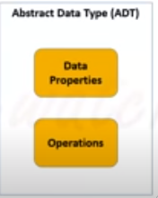
Abstract Data Types
Abstract Data Type (ADT): a definition for a data type solely in terms of a set of values and a set of operations on that data type.
Each ADT operation is defined by its inputs and outputs.
Encapsulation: Hide implementation details.

Slide 20
Abstract Data Types (Cont.)
Def.
a collection of related data items
together with
an associated set of operations
    e.g. whole numbers (integers) and arithmetic operators for addition, subtraction, multiplication and division.
    e.g. Flight reservation
    Basic operations: find empty seat, reserve a seat,
    cancel a seat assignment
    Why "abstract?"
    Data, operations, and relations are studied
    independent of implementation.
What not how is the focus.

Slide 21
Abstract Data Types (Cont.)
Def.
Consists of
    storage structures (aka data structures)
    to store the data items
    and
    algorithms for the basic operations.
Separating the definition of a data type from its implementation.

Slide 22
Data Structure
Is a particular way of storing and organizing data in a computer so that it can be used efficiently
Different kinds of data structures are suited to different kinds of applications and some are highly specialized to specific tasks
provide a means to manage huge amounts of data efficiently, such as large databases and internet indexing services
Usually, efficient data structures are a key to designing efficient algorithms.

Slide 23
Resource (Space)
INPUTS
OUTPUT
Data Structure
ALGORITHM
Resource (Time)

Slide 24
Examples – Factors to Consider
Airline Reservations Trans-Fryslan Airlines
    Attempt 1:
    Declare as many variables as are the available seat and assign a value to each variable.
    → Horrible algorithms for the basic operations!
    Attempt 2:
    Declare an array of length equal to the Maximum seats available and then specify whether the seat is occupied or unoccupied.
  → Nice algorithms for the basic operations!

Slide 25
The Need for Data Structures
Goal: to organize data
Criteria: to facilitate efficient
  storage of data
  retrieval of data
  manipulation of data
Complex computing tasks are unlike our everyday experience
More complex applications demand more calculations, searching and sorting
More powerful computers?
⇒ more complex applications
Data structures organize data
⇒ more efficient programs.

Slide 26
Selecting a Data Structure
Select a data structure as follows:
Analyze the problem to determine the resource constraints a solution must meet.
Determine the basic operations that must be supported. Quantify the resource constraints for each operation.
Select the data structure that best meets these requirements.
Notes:
Typically want the “simplest” data structure that will meet the requirements.

Slide 27
Fundamental Data Type
List - Sequential arrangement
Stack - Limited access list
Queue - Limited access list
Tree - Hierarchical arrangement
Graph - General non-linear structure
Table - Associative structure
Matrix - Arrangement in two or more dimensions

Slide 28
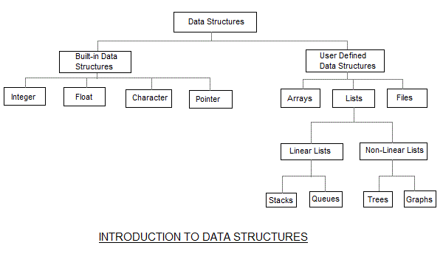

Slide 29
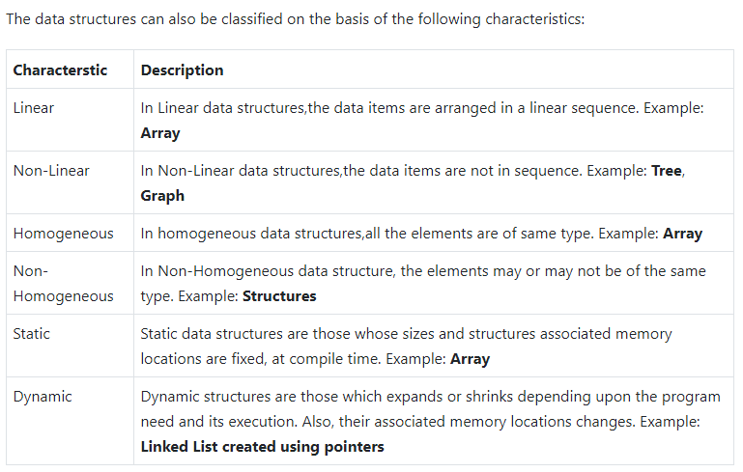

Slide 30
Algorithms
The logical steps to solve a problem

Slide 31
Why study algorithms?
Make computers more efficient
  runs faster
  process more data
A bad algorithm on supercomputer can be worse than a good algorithm on PC.

Slide 32
Why study algorithms?
The study of algorithms have been recognized as the cornerstone of computer science.
  David Harel writes:
“Algorithmics is more than a branch of computer science. It is the core of computer science, and, in all fairness, can be said to be relevant to most science, business, and technology”

Slide 33
The Definition of Algorithm
  An algorithm is a finite sequence of instructions, each of which has a clear meaning and can be performed with a finite amount of effort in a finite length of time.
[Aho, Hopcroft & Ulman 1975]

Slide 34
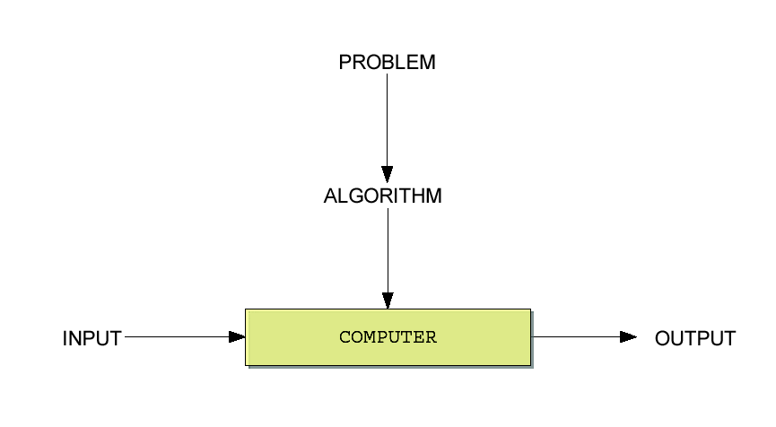
Algorithms and Computers

Slide 35
What is an Algorithm?
There are two parts to a computer program.
There is the process or sequence of steps which are necessary to complete the given task and
the translation of this process into a language which the computer can understand.

Slide 36
Criteria for Algorithm
Input: Zero or more quantities are externally supplied
Output: At least one desired result is produced
Definiteness: Each instruction must be clear and unambiguous
Finiteness: Algorithm terminates after a finite number of steps
Effectiveness: Each instruction must be feasible and very basic

Slide 37



From Algorithms to Programs
Algorithm: A sequence of instructions describing how to do a task
Problem
Computer Program

Slide 38
Algorithm Representation
Algorithm
Pseudocode
Flow Chart

Slide 39
What is Pseudocode?
Traditionally, flowcharts were used to represent the steps in an algorithm diagrammatically.
These were bulky, difficult to draw and often led to poor program structure.
Pseudocode is the method of writing down an algorithm.
Pseudocode is easy to read and write.
It represents the statements of an algorithm in English like language.

Slide 40
Pseudocodes
A pseudocode is a semiformal, English-like language with limited vocabulary that can be used to design and describe algorithms.
Criteria of a good pseudocode:
  Easy to understand, precise and clear
  Gives the correct solution in all cases
  Eventually ends

Slide 41
Example of Pseudocode
1. Open freezer door
2. Take out Meal
3. Close freezer door
4. Open microwave door
5. Put Meal!
6. Shut microwave door
7. Set microwave on high for 5 minutes
8. Start microwave
9. Wait 5 minutes
10. Open microwave door
11. Remove Meal
12. Close microwave door

Slide 42
Example of Algorithm
procedure Do_Thursday
{
Wake_up ;
Take_A_Shower ;
Eat_Breakfast ;
Drive_To_university ;
Attend_ALGO_Lecture ;
...etc...etc...etc...
Drive_From_university ;
...etc...etc...etc...
}
procedure Do_Week
{
Do_Monday ;
Do_Tuesday ;
Do_Thursday ;
...etc...etc...etc...
}

Slide 43
Pseudocode
Pseudocode = English + Code
relaxed syntax that extended version of the
is easy to read basic control structures
(sequential, conditional, iterative)

Slide 44
Pseudocode Rules
There is currently no standard pseudocode.
There are however certain conventions:
Statements are written in simple English;
Each instruction is written on a separate line;
Logic-showing Keywords are written in UPPER CASE
(e.g. IF , THEN, FOR, WHILE )
Each set of instructions is written from top to bottom with only one entry and one exit;
Groups of statements may be formed into modules, and that group given a name.

Slide 45
Flowchart Symbols
Terminal symbol - indicates the beginning and
end points of an algorithm.
Process symbol - shows an instruction other than
input, output or selection.
Input-output symbol - shows an input or an output operation.
Disk storage I/O symbol - indicates input from or output to disk storage.
Printer output symbol - shows hardcopy printer
output.

Slide 46
Flowchart Symbols cont…
Selection symbol - shows a selection process for two-way selection.
Off-page connector – provides continuation of a logical path on another page.
On-page connector - provides continuation
of logical path at another point in the same
page.
Flow lines - indicate the logical sequence of
execution steps in the algorithm.

Slide 47
The Sequence control structure
A series of steps or statements that are executed in the order they are written in an algorithm.
The beginning and end of a block of statements can be optionally marked with the keywords begin and end.
begin
statement 1.
statement 2.
…
…
statement n.
end
begin
statement 1
statement 2
…
statement n
end

Slide 48
The Sequence control structure
Problem: calculate a person’s age
Begin
read birth year
age = current year – birth year
display age
End
begin
read birth year
Age = current year – birth year
Display age
end

Slide 49
The Selection control structure
Defines two courses of action depending on the outcome of a condition.
A condition is an expression that is, when computed, evaluated to either true or false.
The keyword used are if and else.
Format:
if (condition)
then-part
else
else-part
end_if
No
Yes
Condition?
else-
statement(s)
then-
statement(s)

Slide 50
The Selection control structure
Begin
read age
if (age is greater than 55)
print “Pencen”
else
print “Kerja lagi”
end_if
End
Begin
Read age
YES
age > 55?
NO
Begin
read age
if (age > 55)
print “Pencen”
else
print “Kerja lagi”
end_if
End
print “Pencen”
print “Kerja lagi”
End

Slide 51
Pseudocodes: The Selection control structure
Sometimes in certain situation, we may omit the else-part.
  if (number is odd number)
  print “This is an odd number”
  end_if
Nested selection structure: basic selection structure that contains other if/else structure in its then-part or else-part.
if (number is equal to 1)
print “One”
else if (number is equal to 2)
print “Two”
else if (number is equal to 3)
print “Three”
else
print “Other”
end_if
Example 1
Example 2

Slide 52
Problem: Write a program that reads and displays the age of 10 people (one after another).
For this problem, we need a way to count how many people whose age have been processed (read and displayed). Therefore, we introduce a concept of counter, a variable used to count the number of people whose age have been processed by the program.

Slide 53
Begin
number of users giving his age = 1
while (number of users giving his age <= 10)
read the age from the user.
print the user age.
number of user giving his age + 1
end_while
End
Counter initialisation
Loop condition
Updating counter
Begin
users = 1
while (users <= 10)
read age
print age.
users = users + 1
end_while
End

Slide 54
Begin
users = 1
NO
End
users <= 10?
YES
read age
print age
users =users + 1

Slide 55

Exercise
Draw the flowchart diagram for Example 1 and Example 2

Slide 56
Summary
Any Questions?

